Slide 1
Wrangling
Guillermo Durán González

Slide 2
Cargas
Carga de paquete
if (!require(“tidyverse”)){install.packages(“tidyverse”); library(tidverse)}
Carga de set datos
gapminder_df <- read.table(file = “https://raw.githubusercontent.com/martintinch0/CienciaDeDatosParaCuriosos/master/data/gapminder.csv”, sep=‘;’, header = TRUE, stringsAsFactors = FALSE) class(gapminder_df)
Nombres de columnas
colnames(gapminder_df)

Slide 3
Piping
df_pais<-gapminder_df %>% select(country) %>% filter (country==“Chile”)
Notese que se devuelve un DF
class(df_pais)
Notese que tambien se puede hacer como vector
vector_pais<-(gapminder_df$country) # con $ se crea un vector class(vector_pais)
vector_pais[vector_pais==“Chile”]

Slide 4
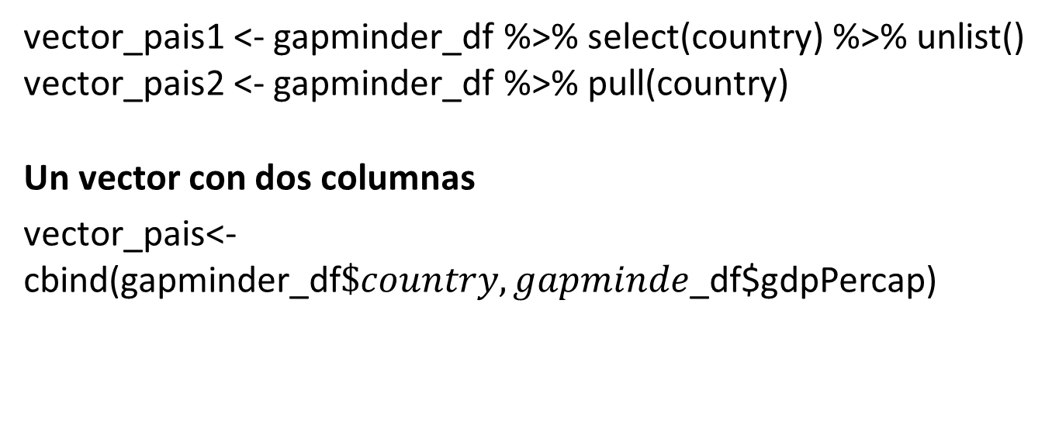
Otras formas de generar vectores
vector_pais1 <- gapminder_df %>% select(country) %>% unlist() vector_pais2 <- gapminder_df %>% pull(country)
Un vector con dos columnas
vector_pais<-cbind(gapminder_df$\$country,gapminde$_df$gdpPercap)

Slide 5
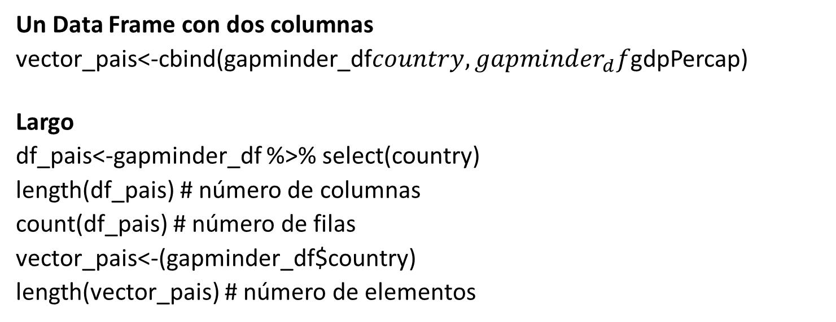
Ahora con Dataframe
Un Data Frame con dos columnas
vector_pais<-cbind(gapminder_df$country,gapminder_{d}f$gdpPercap)
Largo
df_pais<-gapminder_df %>% select(country)
length(df_pais) # número de columnas
count(df_pais) # número de filas
vector_pais<-(gapminder_df$country)
length(vector_pais) # número de elementos

Slide 6
Quitar repetidos
vector_paises3 <- unique(gapminder_df$country) # con vectores length(vector_paises3)
Num_pais<-gapminder_df %>% select(country) %>% unique.data.frame() %>% count() # con dataframe

Slide 7
Seleccionando filas
gapminder_df %>% filter(year == 2002) # Año 2002 gapminder_df %>% filter(country == “Chile”, year == 1962) gapminder_df %>% filter(country == “Chile”, year != 1967) gapminder_df %>% filter(country == “Chile”, year == 1962 | year == 1967)
gapminder_df %>% filter(country == “Chile”,year %in% c(1962,1967))

Slide 8
Ordenandolo todo
gapminder_df %>% select(country, continent, pop) %>% filter(continent==“Americas”) %>% arrange(desc(pop))
gapminder_df %>% select(country, continent, pop) %>% filter(continent==“Americas”) %>% arrange(pop)

Slide 9
Insertar nuevas columnas
new_gapminder <- gapminder_df %>% mutate(pop = pop / 1000000)
head(new_gapminder, n = 3)
df<-gapminder_df %>% mutate(gdp = gdpPercap * pop)
head(df, n = 3)

Slide 10
Agrupando datos
gapminder_df %>% group_by(year, continent) %>% summarise(mean_lifeExp = mean(lifeExp))
gapminder_df %>% group_by(year, continent) %>% summarise(poor_country = min(gdpPercap), rich_country = max(gdpPercap), poor_country_nom = country[gdpPercap == poor_country], rich_country_nom = country[gdpPercap == rich_country])
gapminder_df %>% group_by(year, continent) %>% mutate(dif_lifeExp = lifeExp - mean(lifeExp))

Slide 11
Pivotenado con tibble
gapminder_continente <- gapminder_df %>% select(country, continent,year,pop) %>% filter(continent==“Asia”) %>% mutate(pop = round(pop / 1000000,1)) %>% arrange(country,year)
wider<-gapminder_continente %>% pivot_wider(names_from = year,values_from = pop)

Slide 12
Reconstruyendo lo pivoteado
longer1 <- wider %>% pivot_longer(cols = 3:14, names_to = ‘year’, values_to = ‘pop’) %>% arrange(country,year)
longer2 <- wider %>% pivot_longer(cols = -c(country,continent), names_to = ‘year’, values_to = ‘pop’) %>% arrange(country,year)
identical(gapminder_continente, longer1) #comprobando si son iguales
class(longer2$year) # verificando el tipo de datos
class(gapminder_continente$year) # verificando el tipo de datos
Ajustando el tipo de datos
longer1<- longer1 %>% mutate(year=as.integer(year))
Ahora si convertir el dataframe en tibble.
gapminder_continente<-gapminder_continente %>% as_tibble(gapminder_continente) identical(gapminder_continente, longer1)

Slide 13
Pruebe el siguiente código
mortalidadInfantil <- read.table(file=“https://raw.githubusercontent.com/martintinch0/CienciaDeDatosParaCuriosos/master/data/MortalidadInfantilLong.csv”, sep = “,”, header = TRUE, stringsAsFactors = FALSE)
gapminder_chile <- gapminder_df %>% filter(country == “Chile”)
gapminder_chile1952 <- gapminder_chile %>% filter(year==1952)
mortalidadInfantilchile1952 <- mortalidadInfantil %>% filter(Year==1952 & country==“Chile”)
gapminder_chile1952 <- left_join(gapminder_chile1952, mortalidadInfantilchile1952, by=“country”)
gapminder_chile1952
gapminder_chile1952 <- right_join(gapminder_chile1952, mortalidadInfantilchile1952, by=“country”) gapminder_chile1952
gapminder_chile1952 <- inner_join(gapminder_chile1952, mortalidadInfantilchile1952, by=“country”) gapminder_chile1952

